Slide 1

Building A Purposeful &
Rewarding Future With Accountancy
An Accountancy Education & Career Guidance Playbook

Slide 2


THIS IS ACCOUNTANCY: FACTS & FIGURES
Accounting firms providing professional services
Commercial teams in businesses
i.e. in-house finance & accounting functions
~20,000
~100,000
accounting professionals
accounting professionals
Audit, corporate support,
tax compliance, business advisory
Internal audit, financial planning and analysis, treasury, tax
Functions

Slide 3

Accountancy is not
... just going through balance sheets and accounts in the backroom.

Slide 4

Accountancy is...
…. about driving business decisions, ensuring financial integrity, and creating value for companies and society.

Slide 5

Why Choose Accountancy?
REWARDING & DYNAMIC CAREER
PROGRESSION & GROWTH OPPORTUNITIES
PURPOSEFUL WORK THAT IMPACTS BUSINESSES
Notes:
1. REWARDING & DYNAMIC CAREER
Accountancy offers a rewarding and dynamic career, with competitive starting salaries and long-term earning potential. Accountancy opens many doors of opportunities, and accountants are highly sought after throughout their career.
2. PROGRESSION & GROWTH OPPORTUNITIES
Accountancy provides progression and growth in diverse areas such as sustainability reporting, business strategy and advisory. It provides useful and transferable skills and offers continual developmental opportunities.
3. PURPOSEFUL WORK THAT IMPACTS BUSINESSES & PROTECTS PUBLIC INTEREST
Accountants find purpose and a sense of fulfilment in the work they do as it impacts the financial integrity of businesses. Accountants who are professional, competent and act with integrity also help safeguard Singapore’s reputation as a trusted place for business.

Slide 6







Demand for accountancy talent is high
  Singapore is a financial business hub. There is high demand for accountancy services and accountancy professionals.
  Emerging trends such as new technologies, heightened expectations of accountants to protect public interest, and increased focus on ESG will add to the demand for accountants.
  New areas of growth in sustainability reporting and assurance, IT audits, business valuation, financial forensics etc., offer new opportunities for accountants.

Slide 7
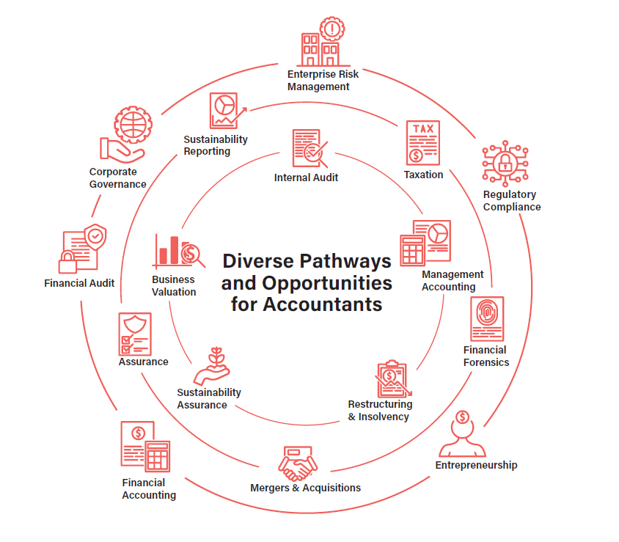
Accountancy offers
REWARDING & DYNAMIC CAREER
diverse pathways and
exciting opportunities,
with good career
prospects.
PURPOSEFUL WORK THAT IMPACTS BUSINESSES

Slide 8
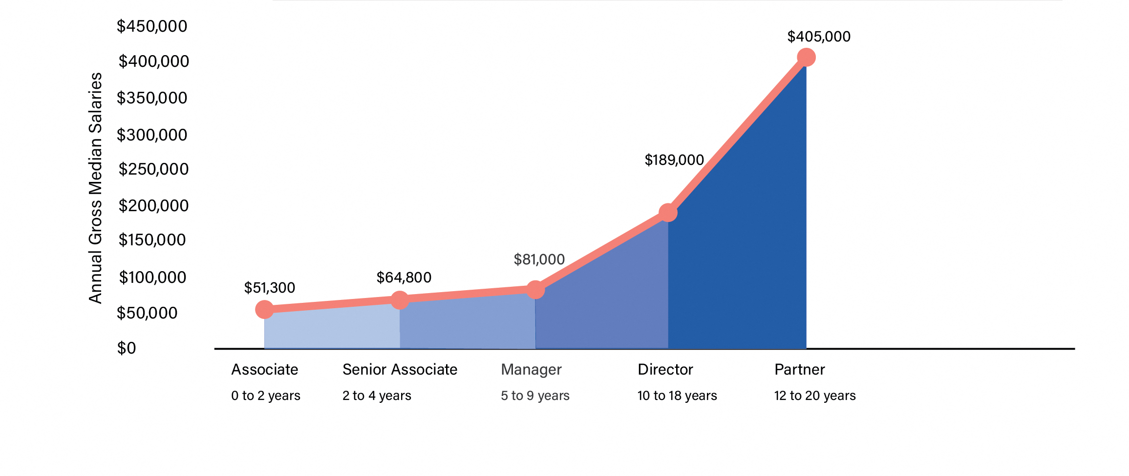
Salary Progression of
accountancy professionals
in accounting entities

Slide 9


The Accountant’s Archetypes
Business Health Specialists
Business Advisors & Planners
Financial Stability – Accountants monitor cash flow and manage risks to prevent financial breakdowns.
Strategic Decision-Making – They provide insights for cost management, restructuring, and long-term success.
Issue Diagnosis & Correction – Accountants identify financial problems and implement corrective actions
Example Pathways: Assurance, Internal Audit, Restructuring and Insolvency & Enterprise Risk Management
Financial Insights – Accountants analyse financial performance to shape long-term strategies.
Growth Planning – They forecast financial needs to support sustainable expansion.
Cash Flow Management – Accountants track and optimise cash flow for stability.
Example Pathways: Financial Accounting, Management Accounting, Merger & Acquisition, Business Valuation, Taxation and Treasury Management
Notes:
1) As Business Health Specialists, accountants ensure financial stability by monitoring cash flow, managing risks, and making strategic decisions that prevent financial breakdowns. They diagnose issues within a company’s financials and prescribe corrective actions, such as restructuring or cost management, to ensure long-term success.
Example Pathways: Assurance, Internal Audit, Restructuring and Insolvency & Enterprise Risk Management
2) Accountants do more than manage finances—they act as Business Advisors and Planners, offering insights into a company’s financial performance and helping shape long-term strategies. They guide organisations in planning for future growth by forecasting financial needs and tracking cash flow to support sustainable business decisions.
Example Pathways: Financial Accounting, Management Accounting, Merger & Acquisition, Business Valuation, Taxation and Treasury Management

Slide 10

The Accountant’s Archetypes
Cross-Disciplinary opportunities (Data Analytics, AI)
Climate Change Warriors
Sustainability Integration – Accountants align financial strategies with sustainability goals.
Environmental & Social Impact – They track carbon footprints and ensure fair labor practices.
Governance & Compliance – Accountants uphold governance standards for responsible business operations.
Example Pathways: Sustainability Reporting and Assurance
Tech-Driven Analysis – Accountants use AI and data analytics to detect fraud and uncover insights.
Strategic Decision-Making – Data-driven recommendations help optimize business performance
Regulatory Compliance – AI tools support adherence to financial regulations and governance.
Example Pathways: IT Audit, Financial Forensics and Corporate Governance
Notes:
3) Accountants play a key role as Climate Change Warriors, helping businesses align financial strategies with sustainability goals. By incorporating sustainable practices into companies’ operations, accountants help companies monitor their environmental and societal impact from tracking carbon footprints to ensuring fair labour practices and governance standards.
Example Pathways: Sustainability Reporting and Assurance
4) With the integration of data analytics and AI, accountants are evolving into financial detectives who use technology to analyse data, detect fraud and provide strategic insights. These tools enable accountants to offer data-driven recommendations that enhance business performance and ensure compliance.
Example Pathways: IT Audit, Financial Forensics and Corporate Governance

Slide 11
Dispelling Common Myths
1
2
3
4
5
More Than Just
Number-Crunching
Long Hours Are
Not The Norm
AI Won’t Replace
Accountants
Accounting Is Not
Going Out of Style
Accounting
Is Not Boring
Accountants go beyond numbers—advising on business strategy, improving efficiency, and addressing emerging challenges like climate and sustainability reporting.
Accounting isn't just long hours—busy periods are seasonal. Firms now prioritize work-life balance with flexible work arrangements, employee well-being, and staff appreciation initiatives.
AI won’t replace accountants—technology automates tasks, allowing them to focus on strategic decision-making, data analytics, and providing valuable business insights.
Accountants are financial stewards, ensuring market stability through ethics and insights. As the profession evolves with technology and ESG, new opportunities emerge for impactful contributions.
Accounting is a dynamic career—modern accountants analyze, forecast, and advise, solving complex problems while enjoying strong earning potential and career growth.
Notes:
More Than Just Number Crunching: Many believe that accountancy is solely about crunching numbers. However, accountants are specialists in various field of expertise, including advising on business transactions and restructuring, improving organisational controls and efficiency, and helping businesses tackle emerging challenges such as climate
and sustainability reporting.
Long Hours Are Not The Norm: Another myth is that accountants work long hours year-round. In truth, extended hours are usually seasonal, corresponding to filing deadlines and regulatory obligations. The profession has also made significant strides in improving work life balance with many firms having already introduced flexible working arrangements as a core part of their culture and are investing in employee wellbeing and staff appreciation initiatives. These moves reflect a profession that desires to be progressive and is prepared to embrace change.
AI Won’t Replace Accountants: A common misconception is that AI will render accountants obsolete. In reality, technology streamlines repetitive tasks, enabling accountants to focus on strategic decision-making and valuable insights. Demand for accountants remains strong, as their roles evolve towards providing strategic and analytical insights. By leveraging data analytics and digital tools, accountants are able to provide deeper insights and sound advice, making the profession dynamic and future-focused.
Accounting Is Not Going Out Of Style: Accountants remain essential as financial stewards and guardians of the capital market. By upholding rigorous ethical standards and providing financial insights and analysis, accountants help mitigate risks and contribute to the overall stability of the economy. The accountancy profession is also continually evolving, driven by emerging technologies and a growing focus on areas such as ESG (Environmental, Social and Governance). As businesses adapt to emerging developments and challenges, the profession offers opportunities for accountants to refresh their skills, and contribute meaningfully in new areas of work and initiatives.
Accounting Is Not Boring: Accounting is an exciting and dynamic field where modern accountants tackle greater responsibilities in analysis, forecasting, and advisory roles. They leverage their skills to solve complex problems and uncover financial insights, facing new challenges and opportunities every day. Accountancy also offers a rewarding and dynamic career, with competitive starting salaries and long-term earning potential.

Slide 12
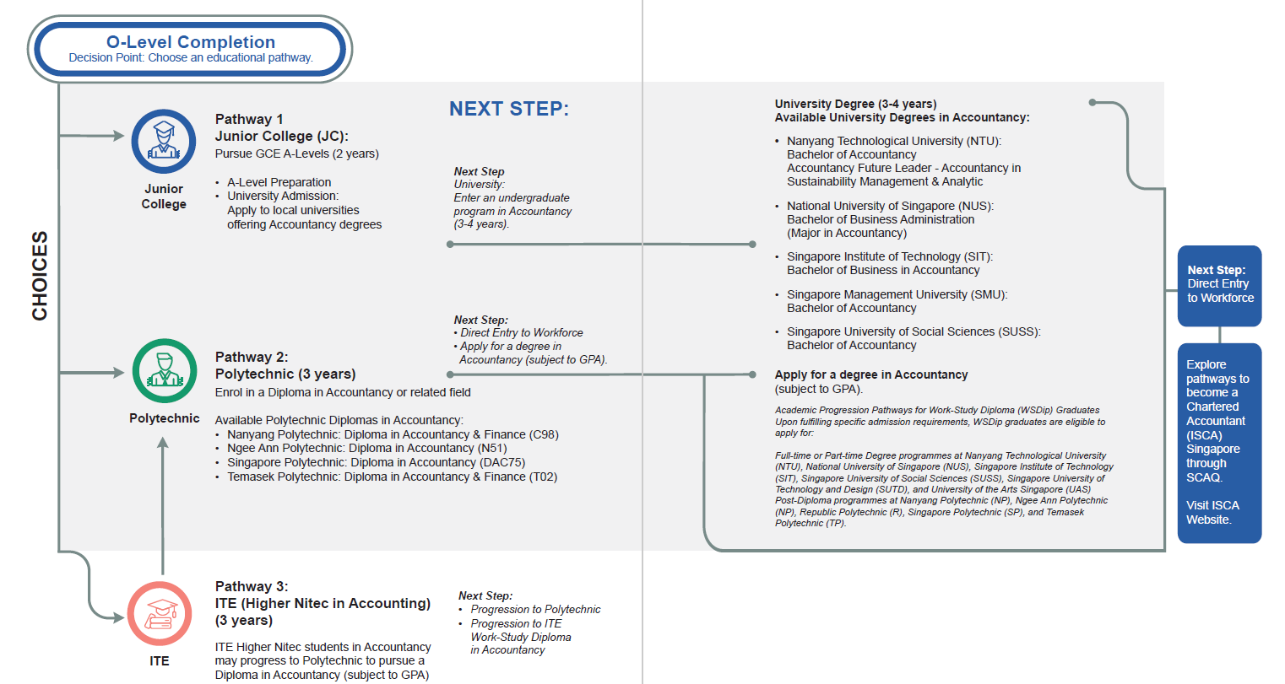
Educational Pathways To Accountancy

Slide 13















01
Analytical Skills
Communication Skills
05
The Data Detective analyses complex data to uncover trends and insights, enabling businesses to make informed decisions
The Financial Storyteller breaks down complex financial data into clear insights, empowering businesses and individuals to make informed decisions.
Desired
Skillset in
Accountancy
02
Attention to Details
Organisational Skills
06
The Eagle Eye accountant, with keen attention to detail, detects inconsistencies and ensures precise, accurate financial records.
The Organiser Extraordinaire ensures seamless operations by managing tasks, deadlines, and reports with exceptional precision.
03
Integrity & Ethics
Adaptability
07
The Guardian of Trust upholds integrity and transparency, ensuring ethical financial practices and building trust in the business world.
The Adaptable Ace stays ahead by mastering new technologies and adjusting to evolving regulations, ensuring agility in a fast-paced business environment.
04
Problem Solving Skills
Strategic Thinking
08
The Puzzle Master solves complex financial challenges with precision, navigating tax regulations and budgets to keep businesses on track.
The Strategy Sage leverages strategic thinking to guide businesses toward growth, stability, and long-term success.

Slide 14



Scholarships in Accountancy
UNIVERSITIES TIER 1
  Disbursement of up to S$3,850 in support of living expenses plus up to 50% of awardee’s tuition fee for academic year
UNIVERSITIES TIER 2
Singapore Citizen (SC) or Permanent Resident (PR) pursuing or has been admitted to his/her full-time Accountancy Diploma/Degree course in Polytechnic/University
  Disbursement of up to S$2,500 in support of living expenses plus up to 50% of awardee’s tuition fee for academic year
ISCA
CARES
BURSARY
POLYTECHNIC TIER 1
  Disbursement of up to S$3,850 in support of living expenses plus up to 100% of awardee’s tuition fee for academic year
POLYTECHNIC TIER 2
  Disbursement of up to S$2,500 in support of living expenses plus up to 100% of awardee’s tuition fee for academic year
https://isca.org.sg/about-us/isca-cares/our-programme/isca-cares-ambassador

Slide 15

Your Next Steps
To learn more about accountancy as a career, find out more here

